Slide 1
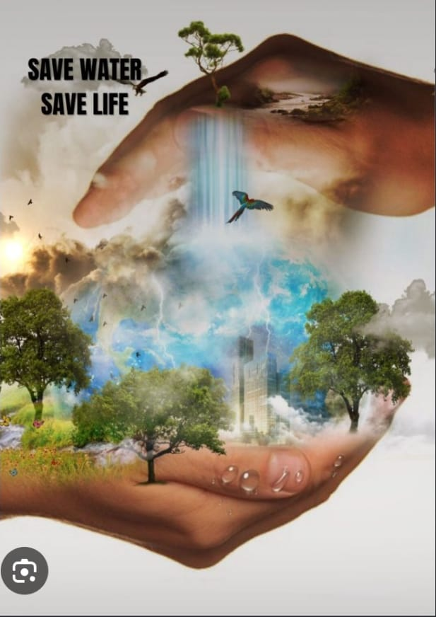
Name- Princy
Trade -AIPA NSTI(W),ALLAHABAD
Date-17/09/2026
EVERY DROP COUNTS
Notes:
“Good morning everyone. Today I am going to talk about the importance of water conservation. Water is essential for every living organism, so saving water is our responsibility.”

Slide 2


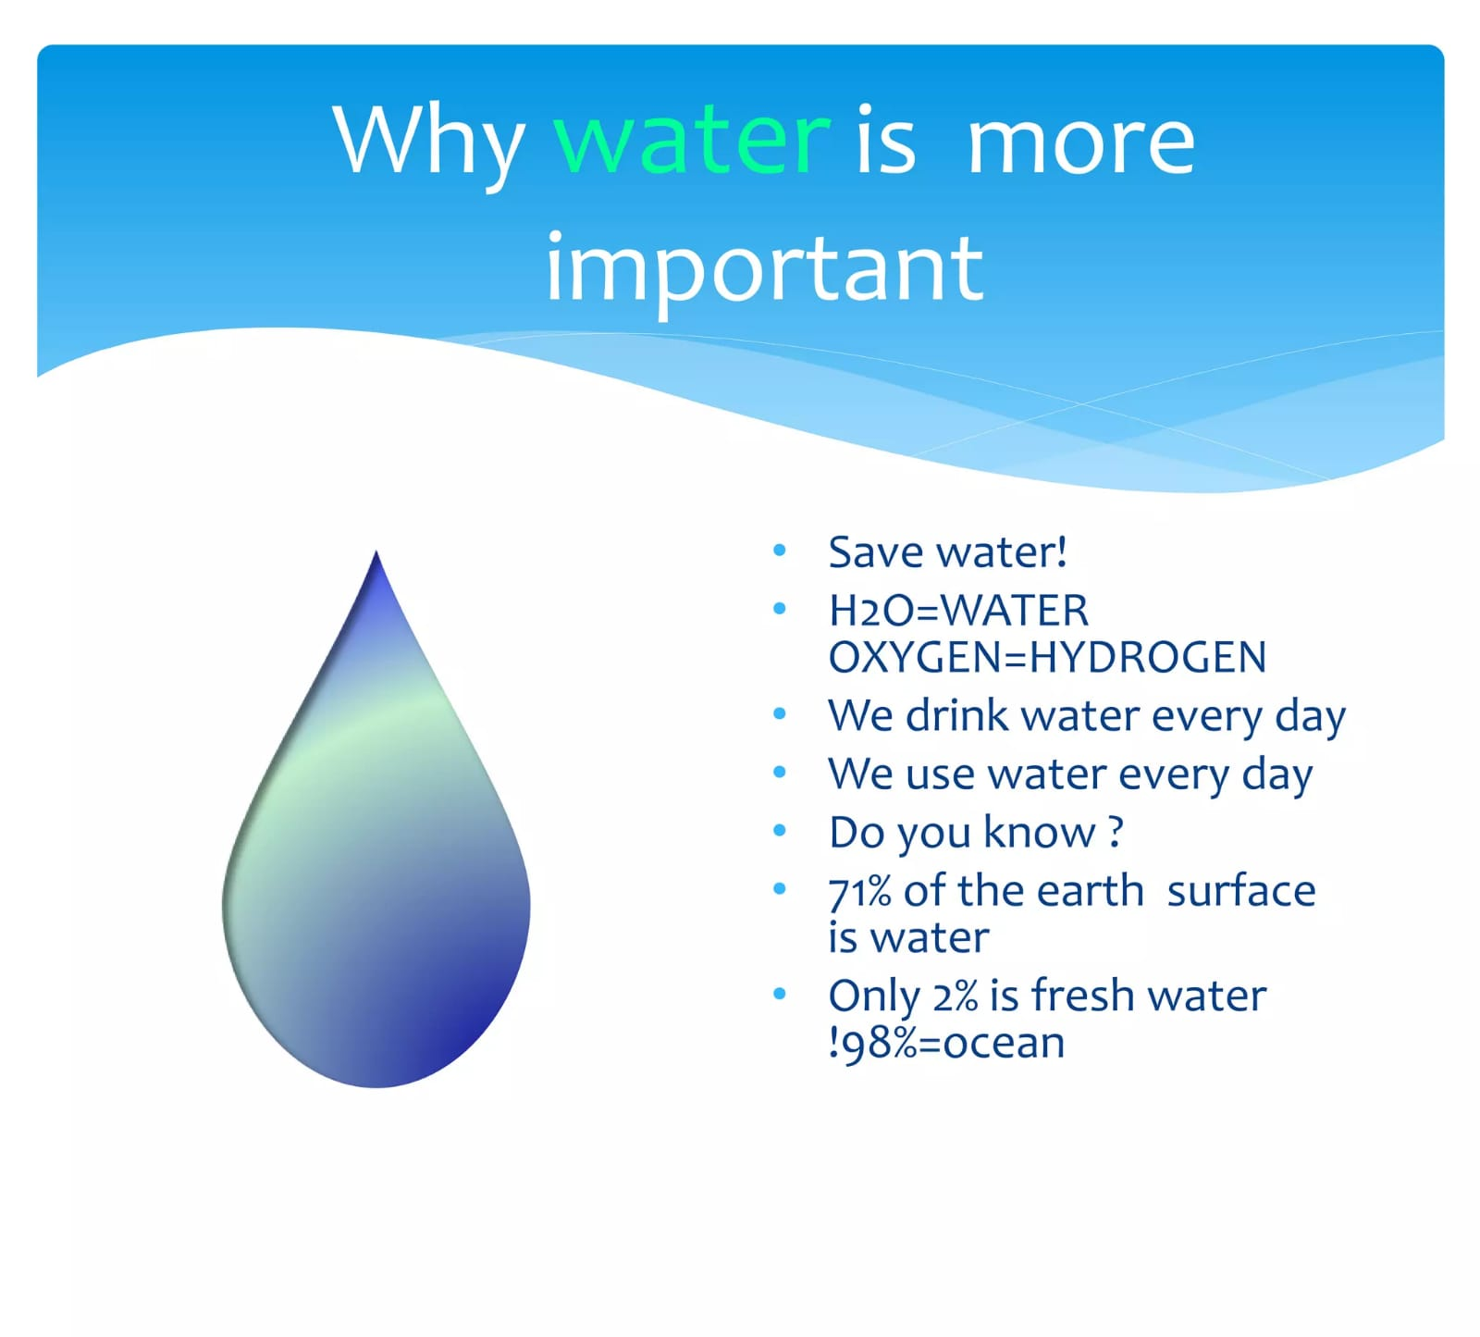
Importance of Water
Water is essential for all living beings.
It is necessary for drinking, cooking and sanitation.
Plants need water for growth.
Water supports agriculture and food production.
Rivers, lakes and oceans support ecosystems.
Our daily life depends on clean and safe water.
Notes:
Water is necessary for drinking, agriculture, sanitation and almost every aspect of life. Without sufficient clean water, humans, animals and plants cannot survive.”

Slide 3

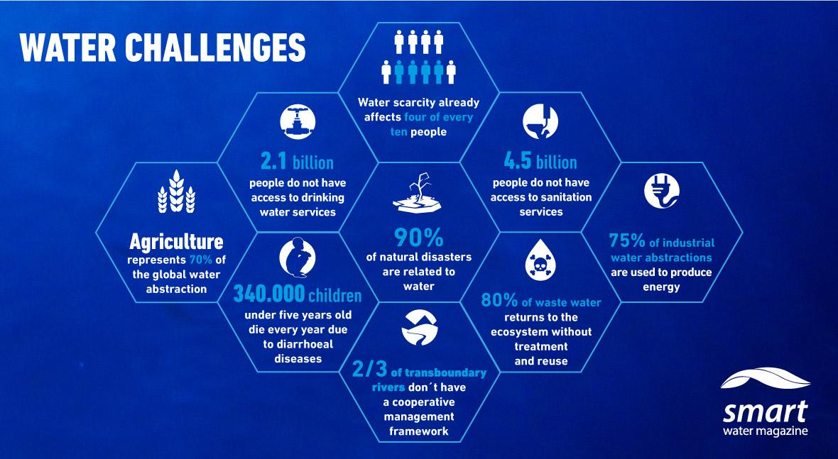
Current Water Challenges
Water Scarcity →
Pollution →
Groundwater Depletion →
Climate Change

Slide 4
Major Causes of Water Wastage
WATER WASTAGE
🚿 Long Showers
🏭 Industrial Waste
🌾 Inefficient Irrigation
👁️❌Lack of awareness
🚰 Leaking Taps
“Water is wasted not because it is unlimited, but because we often fail to value every drop.”
Notes:
“Major causes of water wastage include leaking taps, unnecessary use of water, over-irrigation and lack of awareness.”

Slide 5
Water Conservation Methods
> “Every drop wasted today can become a shortage tomorrow. Understanding the causes of water wastage is the first step toward saving it.”
1.. Rainwater Harvesting – Collect and store rainwater for future use.
2. Fix Leaking Taps & Pipes – Repair leaks immediately to prevent water loss.
3. Use Water Wisely – Turn off taps when not needed and avoid unnecessary usage.
4. Efficient Irrigation – Use drip irrigation and sprinkler systems to reduce agricultural water waste.
5. Reuse Water – Reuse suitable wastewater for gardening, cleaning, or other non-drinking purposes.
6. Protect Water Bodies – Keep rivers, ponds, lakes, and groundwater sources clean and protected.
7. Spread Awareness – Encourage people to understand the importance of saving water.
Notes:
“We can conserve water by fixing leaks, turning off taps when not needed, reusing water where appropriate and adopting rainwater harvesting.”

Slide 6
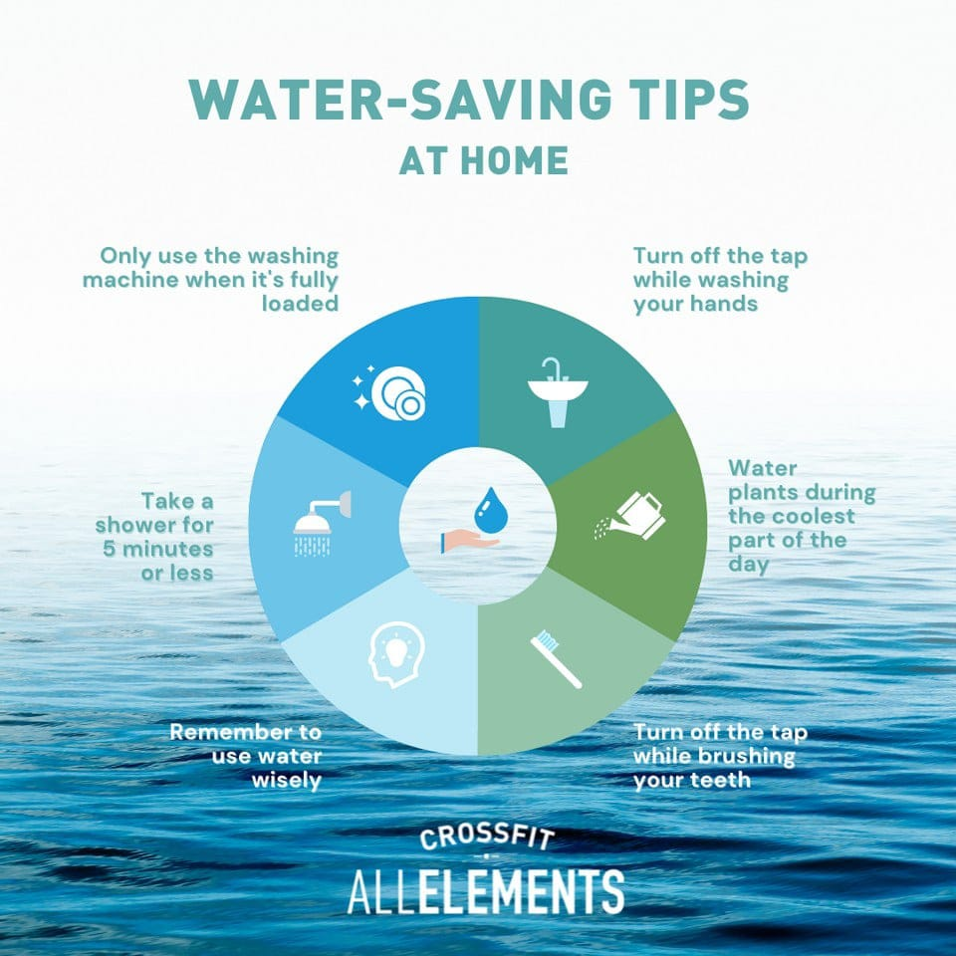
Water Conservation at Home
Activity | Water-Saving Practice | Benefit
Brushing | Turn off tap | Saves water
Bathing | Use bucket | Reduces wastage
Washing | Use full loads | Saves water
Kitchen | Reuse suitable water | Reduces waste

Slide 7
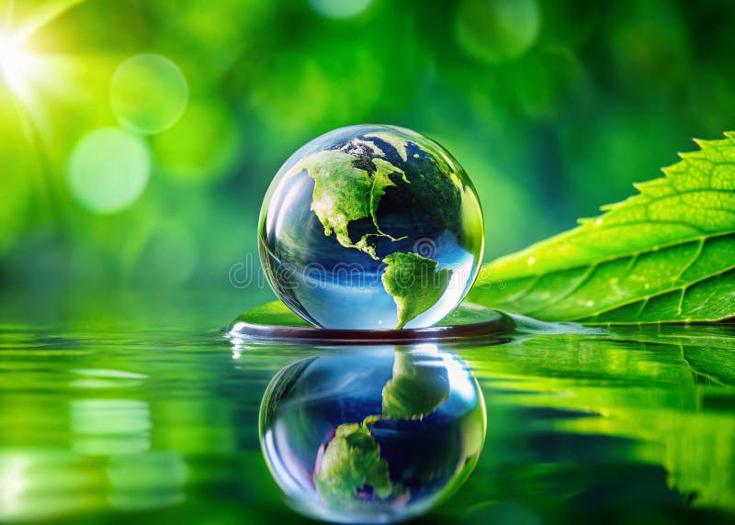
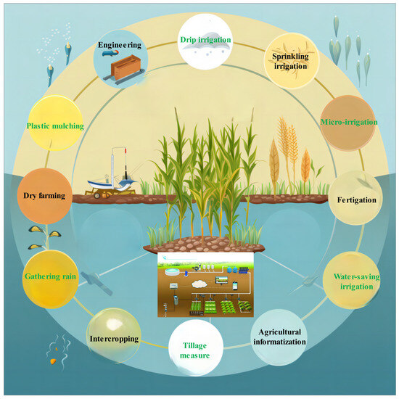
Water Conservation in Agriculture
🌱 Drip Irrigation~
Delivers water directly to plant roots.
💦 Sprinkler Irrigation~
Distributes water efficiently.
🌧️ Rainwater Harvesting~
Stores rainwater for agricultural use.
🌾 Proper Irrigation Scheduling~
Avoids unnecessary watering.

Slide 8
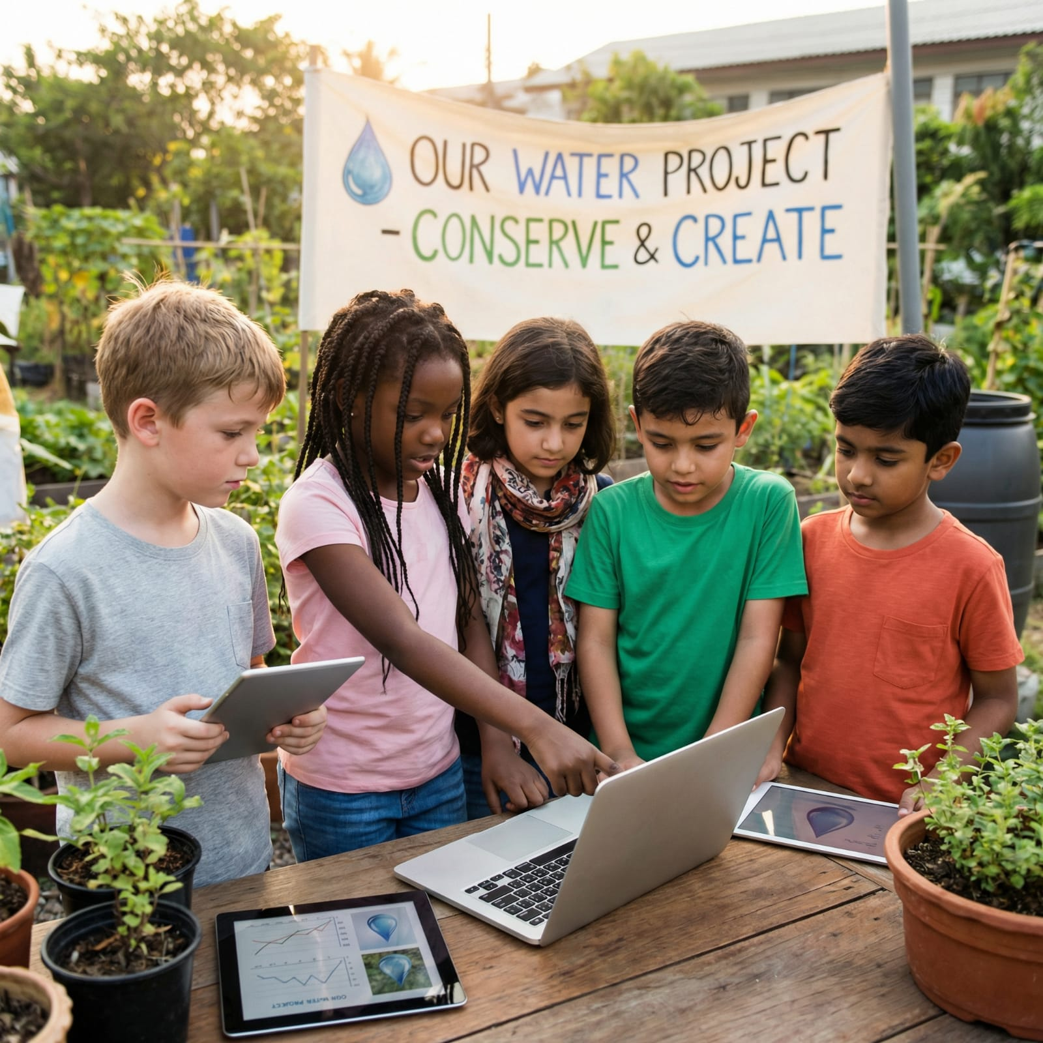
Role of Students
🎓 Spread Awareness
Tell others why water matters.
🚰 Avoid Wastage
Close taps properly.
🌱 Participate
Join water conservation activities.
📢 Lead by Example
Practise water-saving habits every day.

Slide 9
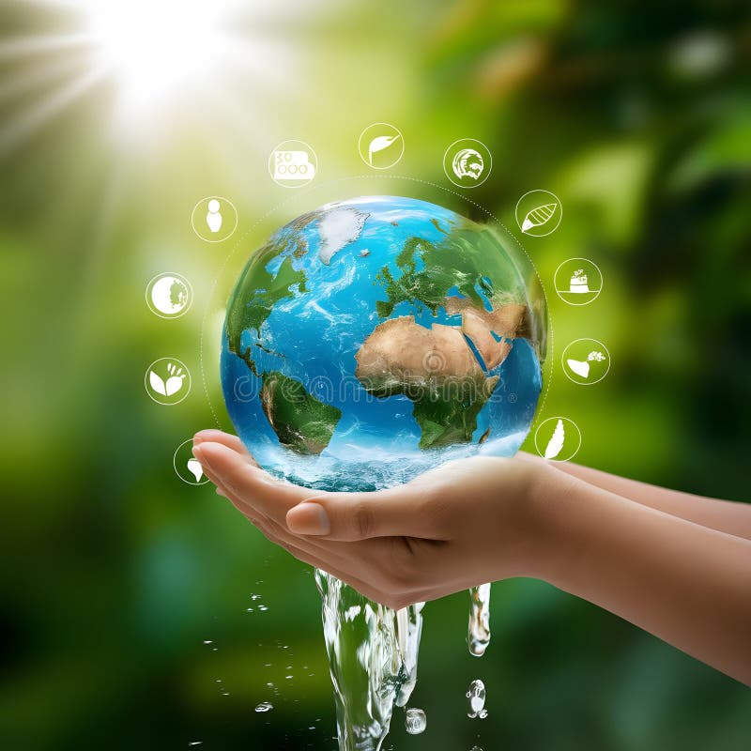
Do's and Don'ts
✅ DO'S | ❌ DON'TS
Turn off taps. . | Don't leave taps running.
Fix leaking taps. | Don't waste drinking water.
Reuse water when possible. | Don't pollute rivers and lakes.
Collect rainwater. | Don't use excessive water.
Use water carefully. | Don't ignore leaks.

Slide 10
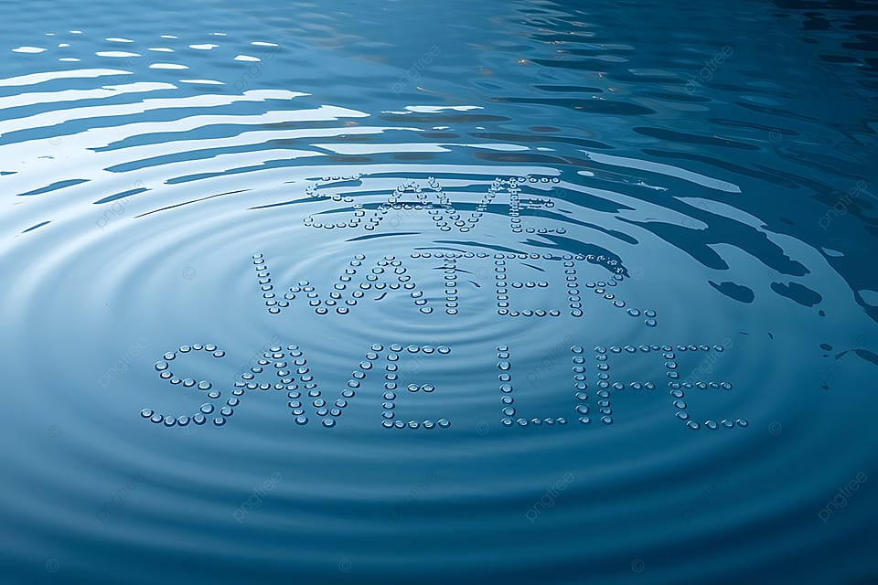
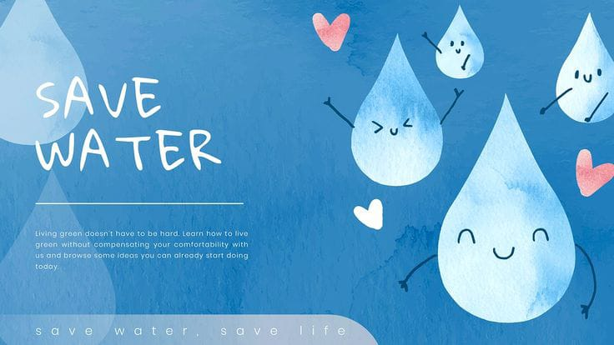
Conclusion
Water is not an unlimited resource; it is the foundation of life on Earth.
By reducing wastage, reusing water, harvesting rainwater, and spreading awareness, we can protect this precious resource.
“Save Water Today, Secure Life Tomorrow.”
Every drop we save today is a step towards a safer and sustainable future. 🌍💧
Notes:
“Saving water is not only an environmental responsibility but also a responsibility towards future generations. Every small effort can make a difference. Save water, save life.”

Slide 11


